Slide 1
Redistributing Data Across Geographies
Problem: Administrative or survey data do not align with geographies of interest (e.g., Supervisor Districts, School Attendance Areas).
Solution: Use data direct aggregation, if possible, alternatively develop synthetic populations based on data and redistribute.
Synthetic re-distribution based on variables of interest. Methods for generating synthetic data include
Iterative Proportional Fitting (IPF)
Multiple Imputation (MI)
Notes:
This is a challenge that arises when we build community profiles with public administrative and survey data.
I will explain each of these methods in detail.

Slide 2
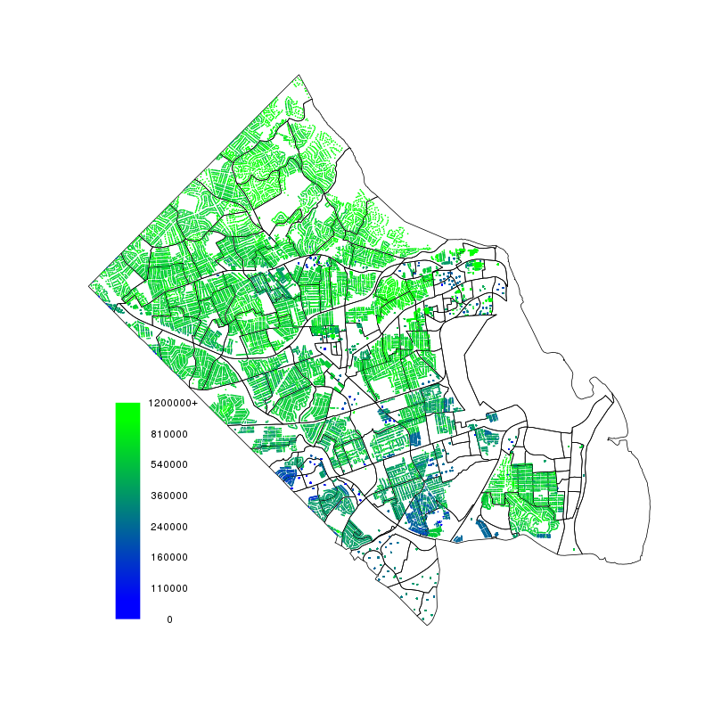
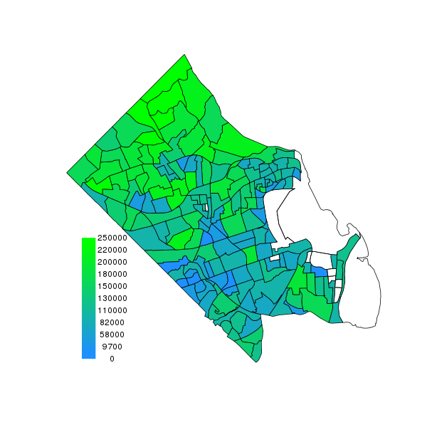
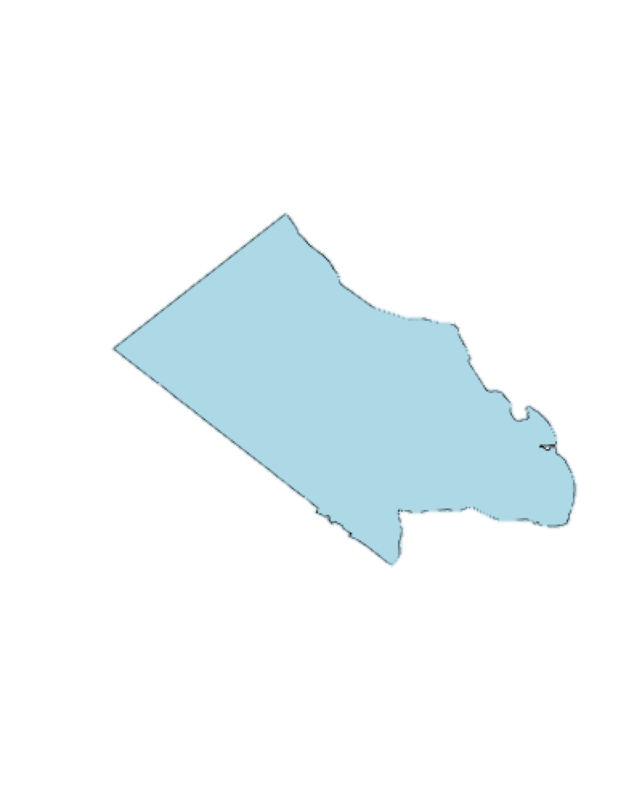
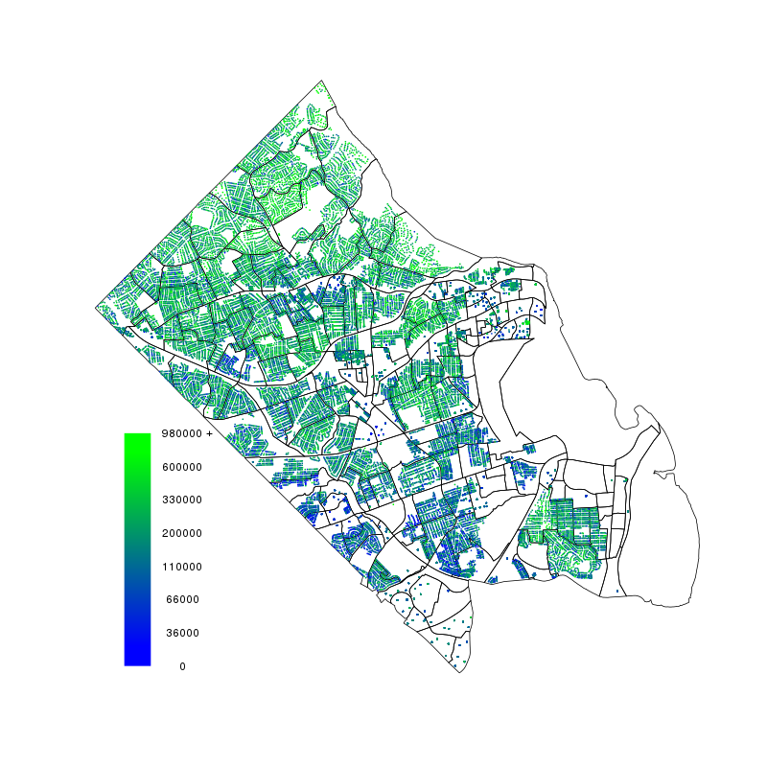
Example: Inferring household attributes in Arlington
Statistical
Sample
Local Data
housing price
tax amount from real estate tax assessments
ACS
Income summary
- by block group
ACS Microdata
housing price
tax amount
income
- county sample
Household level Imputation
housing price
tax amount
income
Notes:
Application: generating synthetic households in Arlington County Virginia
A project for HUD, assessing disclosure risk of American Housing Survey.
Simple example of what our data looks like for the imputaiton of household income using tax amount and property value.
Tax data, Income by block group, ACS microdata (whole county sample) are inputs, and we get household level imputation.

Slide 3
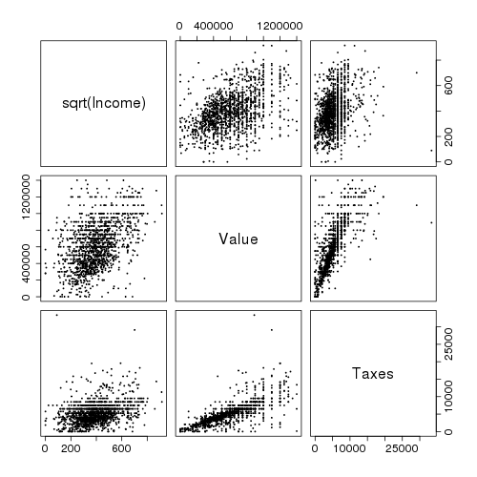
Example: Inferring household attributes in Arlington
Local Data
housing price
tax amount from real estate tax assessments
ACS
Income summary
- by block group
ACS Microdata
housing price
tax amount
income
- county sample
Household level Imputation
housing price
tax amount
income
Notes:
Application: generating synthetic households in Arlington County Virginia
A project for HUD, assessing disclosure risk of American Housing Survey.
Simple example of what our data looks like for the imputaiton of household income using tax amount and property value.
Tax data, Income by block group, ACS microdata (whole county sample) are inputs, and we get household level imputation.

Slide 4
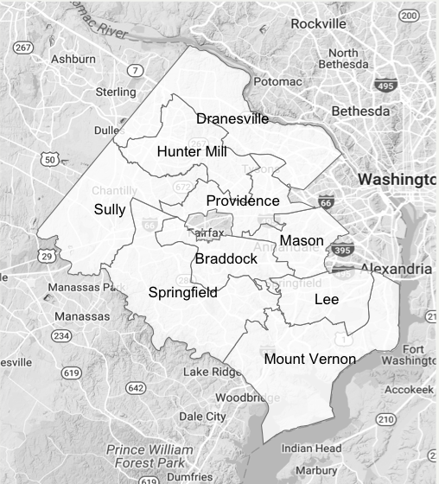
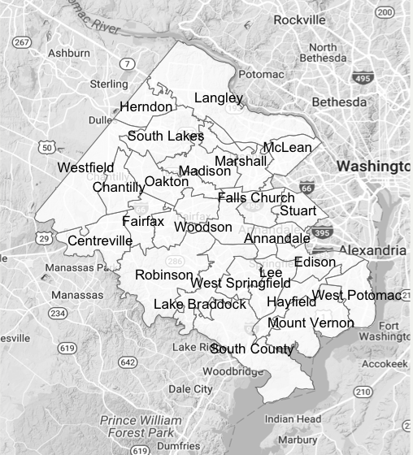
Example: Fairfax County, Virginia Supervisor Districts and High School Attendance Areas
Supervisor Districts
School Attendance Areas
Notes:
Example: Based on work that we did with Fairfax County – focused on factors that influence obesity.
Supervisor districts are political boundaries

Slide 5
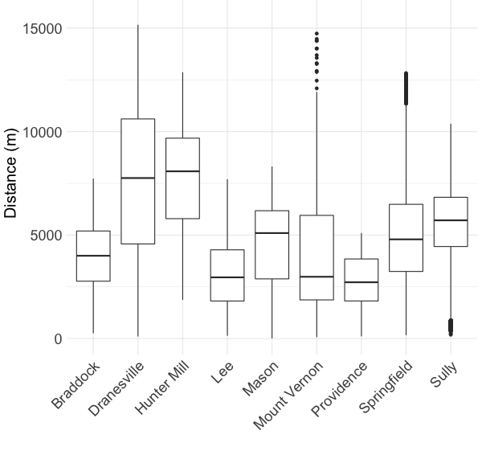
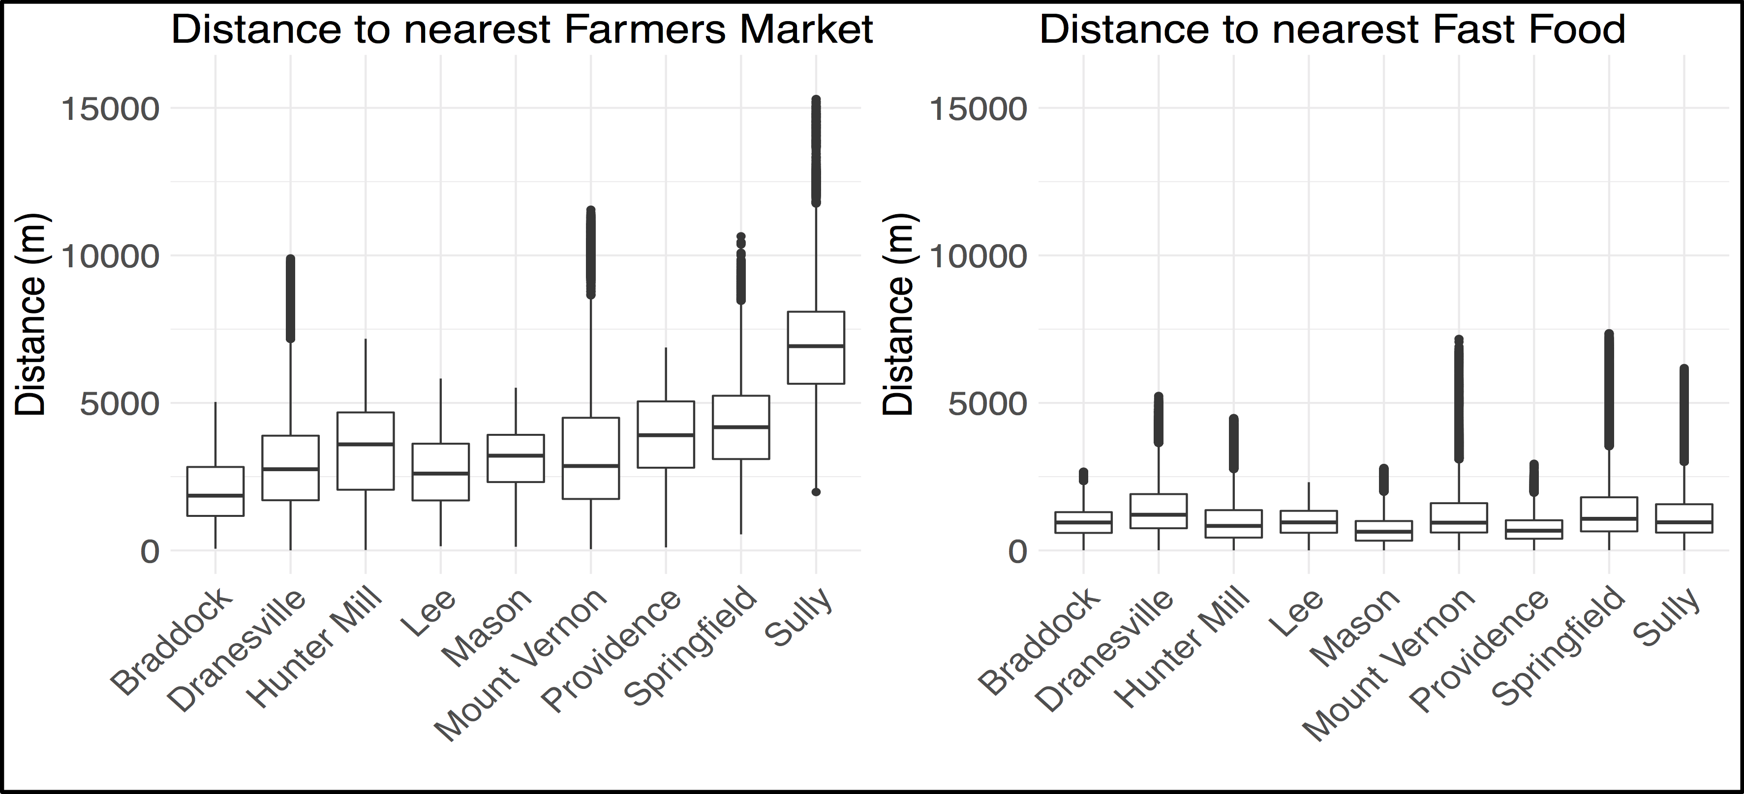
Direct aggregation based on location of housing units
Distance to nearest Recreation Center
Geocoding owner-occupied local housing stock
Adding rental units typically requires imputation
Examples of place data:
All restaurants
Fast Food restaurants
Farmer’s Markets
Community Gardens
Recreation Centers
SNAP Retailers
Parks

Slide 6
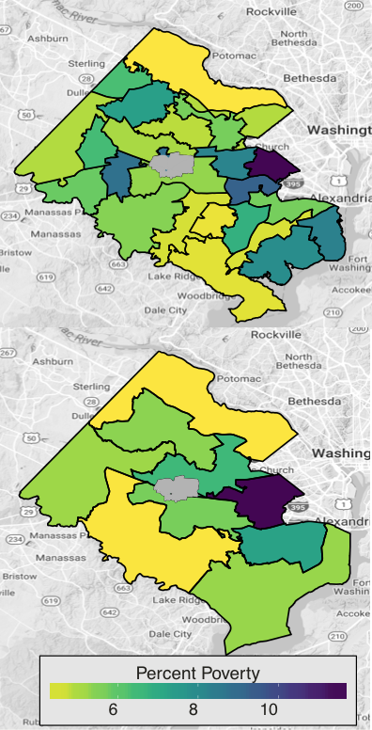
Re-distribution of data based on synthetic populations
Data Sources: American Community Survey
Microdata (individual responses) published at the level of Public Use Microdata Area
Summary tables published at the level of Census Block Group (tidycensus or American Factfinder)
(optional) Housing tax assessment data
Notes:
Figure 3. Fairfax County, Virginia demonstration of methodologies for redistributing data across relevant geographies. Source: Calculations and maps created by Virginia Tech, Social and Decision Analytics Laboratory, using American Community Survey data 2011-2015 aligned to new geographic boundaries using synthetic methods and data scraped from the website.

Slide 7
Re-distribution of data based on synthetic populations
Combine these data sources to create a synthetic population for Fairfax county at the individual (or household) level.
Then aggregate back up by new geography of interest (e.g. high school pyramids, supervisor districts in Fairfax county). Estimates and errors!
Notes:
Upper plot: High school pyramids
Lower plot: Supervisor districts
Figure 3. Fairfax County, Virginia demonstration of methodologies for redistributing data across relevant geographies. Source: Calculations and maps created by Virginia Tech, Social and Decision Analytics Laboratory, using American Community Survey data 2011-2015 aligned to new geographic boundaries using synthetic methods and data scraped from the website.

Slide 8
IPF Method – Toy example
Show how to use Iterative Proportional Fitting to generate synthetic person data; e.g. Age and Gender for a single block group.
This method requires both marginal summaries and microdata…
Notes:
Source:

Slide 9
Microdata (PUMS)
Gender | Age | Race
…
Male | 18 | White
Female | 48 | White
Female | 36 | Black | …
Male | 56 | Asian
Male | 23 | Black
Female | 37 | White
…

Slide 10
Marginal Summary Tables (ACS)
Age, Block Group 001
0-24 | 25-49 | 50-74 | 75+
104 | 132 | 84 | 50
 | Gender, Block Group 001
 | Male | Female
 | 213 | 157
Notes:
For the ACS, these are accessable using tidycensus or downloading through American FactFinder

Slide 11
IPF Example
 | Age
Gender |  | 0-24 | 25-49 | 50-74 | 75+
 | Male |  |  |  |  | 213
 | Female |  |  |  |  | 157
 |  | 104 | 132 | 84 | 50
Block Group 001
N=370
Notes:
Fienberg, S. E. (1970). An Iterative Procedure for Estimation in Contingency Tables. Annals of Mathematical Statistics 41 (3): 907-917.
Given marginal outcomes IPF produces a maximum entropy estimate (e.g. MLE) of the joint table subject to constraints of the marginals.
[ entropy: -sum(p_i*log(p_i)); negative expectation of loglikelihood of the multinomial distribution for this contingency table ]
Multinomial distribution: n independent trials with k possible outcomes.
Write down PMF (n! / x1! … xk!) p1^x1 ... pk^xk
Problem: No piror information on dependence between marginal distributions (Age and Gender).
Beckman 1996: Estimate prior dependence using the PUMS microdata. Account for this using a 2-step IPF procedure.

Slide 12
IPF Example
IPF estimates a joint table given marginal constraints. The procedure is:
Adjust cells using marginal column totals; divide by (cell column sums / marginal column totals)
Adjust cells using marginal row totals; divide by (cell row sums / marginal row totals)
Iterate (1) and (2) until convergence

Slide 13
IPF Example
 | Age
Gender |  | 0-24 | 25-49 | 50-74 | 75+
 | Male | 50 | 50 | 50 | 50 | 213
 | Female | 50 | 50 | 50 | 50 | 157
 |  | x 104 / 100 | x 132 / 100 | x 84 / 100 | x 50 / 100
Block Group 001
N=370
Notes:
Fienberg, S. E. (1970). An Iterative Procedure for Estimation in Contingency Tables. Annals of Mathematical Statistics 41 (3): 907-917.
Given marginal outcomes IPF produces a maximum entropy estimate (e.g. MLE) of the joint table subject to constraints of the marginals.
[ entropy: -sum(p_i*log(p_i)); negative expectation of loglikelihood of the multinomial distribution for this contingency table ]
Multinomial distribution: n independent trials with k possible outcomes.
Write down PMF (n! / x1! … xk!) p1^x1 ... pk^xk
Problem: No piror information on dependence between marginal distributions (Age and Gender).
Beckman 1996: Estimate prior dependence using the PUMS microdata. Account for this using a 2-step IPF procedure.

Slide 14
IPF Example
 | Age
Gender |  | 0-24 | 25-49 | 50-74 | 75+
 | Male | 52 | 66 | 42 | 25 | x 213 / 185
 | Female | 52 | 66 | 42 | 25 | x 157 / 185
 |  | 104 | 132 | 84 | 50
Block Group 001
N=370
Notes:
Fienberg, S. E. (1970). An Iterative Procedure for Estimation in Contingency Tables. Annals of Mathematical Statistics 41 (3): 907-917.
Given marginal outcomes IPF produces a maximum entropy estimate (e.g. MLE) of the joint table subject to constraints of the marginals.
[ entropy: -sum(p_i*log(p_i)); negative expectation of loglikelihood of the multinomial distribution for this contingency table ]
Multinomial distribution: n independent trials with k possible outcomes.
Write down PMF (n! / x1! … xk!) p1^x1 ... pk^xk
Problem: No piror information on dependence between marginal distributions (Age and Gender).
Beckman 1996: Estimate prior dependence using the PUMS microdata. Account for this using a 2-step IPF procedure.

Slide 15
IPF Example
 | Age
Gender |  | 0-24 | 25-49 | 50-74 | 75+
 | Male | 60 | 76 | 48 | 29 | 213
 | Female | 44 | 56 | 36 | 21 | 157
 |  | 104 | 132 | 84 | 50
Block Group 001
N=370
Notes:
Fienberg, S. E. (1970). An Iterative Procedure for Estimation in Contingency Tables. Annals of Mathematical Statistics 41 (3): 907-917.
Given marginal outcomes IPF produces a maximum entropy estimate (e.g. MLE) of the joint table subject to constraints of the marginals.
[ entropy: -sum(p_i*log(p_i)); negative expectation of loglikelihood of the multinomial distribution for this contingency table ]
Multinomial distribution: n independent trials with k possible outcomes.
Write down PMF (n! / x1! … xk!) p1^x1 ... pk^xk
Problem: No piror information on dependence between marginal distributions (Age and Gender).
Beckman 1996: Estimate prior dependence using the PUMS microdata. Account for this using a 2-step IPF procedure.

Slide 16
IPF Example
IPF produces a maximum entropy estimate of the joint table subject to constraints of the marginals.
No assumption of dependence between marginals (Age and Gender)
Beckman 1996: Estimate dependence using the PUMS microdata; 2-step IPF procedure to adjust.
Implementation in R package mipfp
Notes:
Beckman, R. J., Baggerly, K. A., & McKay, M. D. (1996). Creating synthetic baseline populations. Transportation Research Part A: Policy and Practice, 30(6), 415-429.
[ maximum *entropy estimate: -sum(p_i*log(p_i)); negative expectation of loglikelihood of the multinomial distribution for this contingency table ]

Slide 17
Resampling Microdata
 | Age
Gender |  | 0-24 | 25-49 | 50-74 | 75+
 | Male | 60 | 76 | 48 | 29 | 213
 | Female | 44 | 56 | 36 | 21 | 157
 |  | 104 | 132 | 84 | 50
Block Group 001
N=370
Notes:
Fienberg, S. E. (1970). An Iterative Procedure for Estimation in Contingency Tables. Annals of Mathematical Statistics 41 (3): 907-917.
Given marginal outcomes IPF produces a maximum entropy estimate (e.g. MLE) of the joint table subject to constraints of the marginals.
[ entropy: -sum(p_i*log(p_i)); negative expectation of loglikelihood of the multinomial distribution for this contingency table ]
Multinomial distribution: n independent trials with k possible outcomes.
Write down PMF (n! / x1! … xk!) p1^x1 ... pk^xk
Problem: No piror information on dependence between marginal distributions (Age and Gender).
Beckman 1996: Estimate prior dependence using the PUMS microdata. Account for this using a 2-step IPF procedure.

Slide 18
Resampling Microdata
Simple random sample with replacement, n=60, of men age 0-24.
Gender | Age | Race
…
Male | 18 | White
Female | 48 | White
Female | 36 | Black | …
Male | 56 | Asian
Male | 23 | Black
Female | 37 | White
…
Notes:
Some of these rows will appear more than once in our final sample; e.g. if these are the only two men under 25 in our microdata, we would end up replicating each one of them about 30 times for our synthetic population.
If there are no combinations of men under 25 in the microdata, we have nothing to resample. We get around this by fixing this cell at 0 in the IPF procedure (if combinations don’t exist in our microdata, they can’t exist in our synthetic population). Choosing too many categories to fit IPF may combound this problem.

Slide 19
Resampling Microdata
Block Group | Gender | Age | Race
…
001 | Male | 18 | White
001 | Male | 23 | Black
001 | Male | 23 | Black | …
001 | Male | 18 | White
001 | Male | 23 | Black
001 | Male | 18 | White
…

Slide 20
Resampling Microdata
 | Age
Gender |  | 0-24 | 25-49 | 50-74 | 75+
 | Male | 60 | 76 | 48 | 29 | 213
 | Female | 44 | 56 | 36 | 21 | 157
 |  | 104 | 132 | 84 | 50
Block Group 001
N=370

Slide 21
Attach Location to Synthetic Samples
Final step is to attach lat/longs to our synthetic population. 3 methods of increasing sophistication:
Choose a lat/long sampled uniformly over the Block Group
Sample from actual housing units (requires housing locations)
Match people to housing units (requires detailed housing data)
Notes:
Is like throwing a dart at your block group and letting the synthetic person live there.
Uses actual housing information, so we are still throwing darts but nobody lives in a lake.
e.g. placing people with higher income into houses with a higher property value. This helps us get at sub-blockgroup variation in population.
Have not yet implemented [c] in my code...

Slide 22
Final Synthetic Samples
Block Group | Gender | Age | Race | Latitude | Longitude
…
001 | Male | 18 | White | 38.89988 | -77.16008
001 | Male | 23 | Black | 38.89968 | -77.15981
001 | Male | 23 | Black | 38.89981 | -77.15945
001 | Male | 18 | White | 38.89994 | -77.15918
001 | Male | 23 | Black | 38.90016 | -77.15939
001 | Male | 18 | White | 38.90023 | -77.15966
…
Notes:
From here, we can produce summary estimates for each block group or new geography using lats/longs.

Slide 23
Estimating Variability
To account for error in the IPF procedure, we can repeat these steps over multiple runs for sample-based error estimates.
Each run is a different synthetic realization of Fairfax county.
To account for sampling variability, resample the marginal tables for each run (e.g. using ACS margins of error).

Slide 24
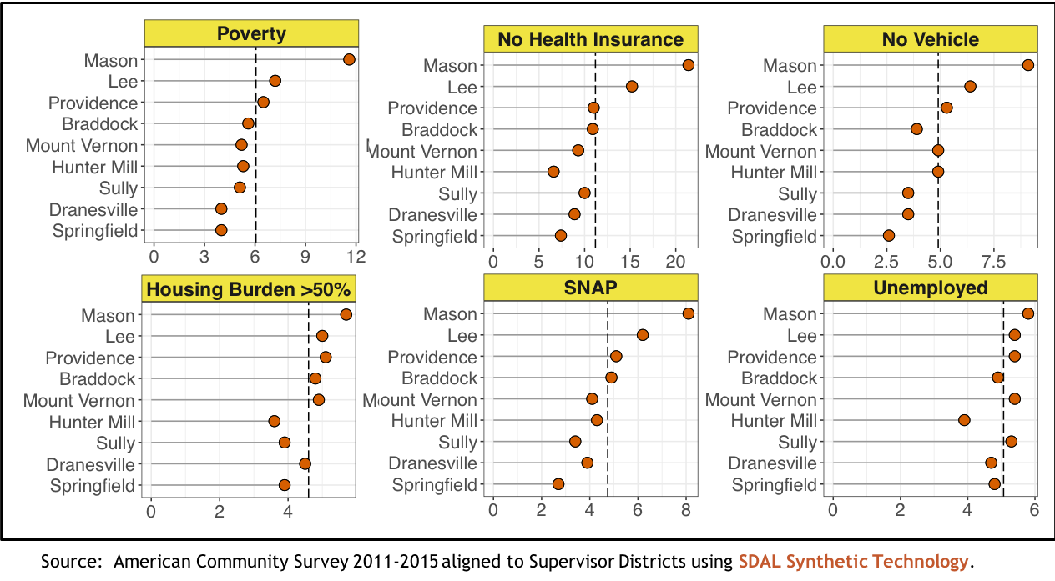
Application: Fairfax County Profiles Dashed lines = Average; Supervisor Districts arranged by Poverty high to low
Notes:
Lollipop plots; comparing districts to average for selected variables from the ACS.
***update: add confidence intervals to these estimates

Slide 25
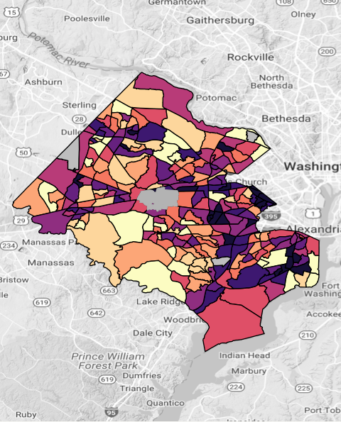
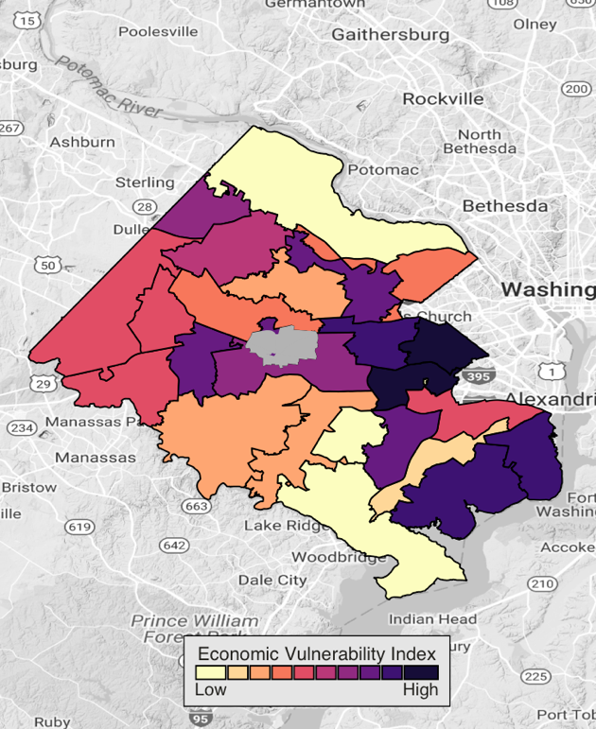
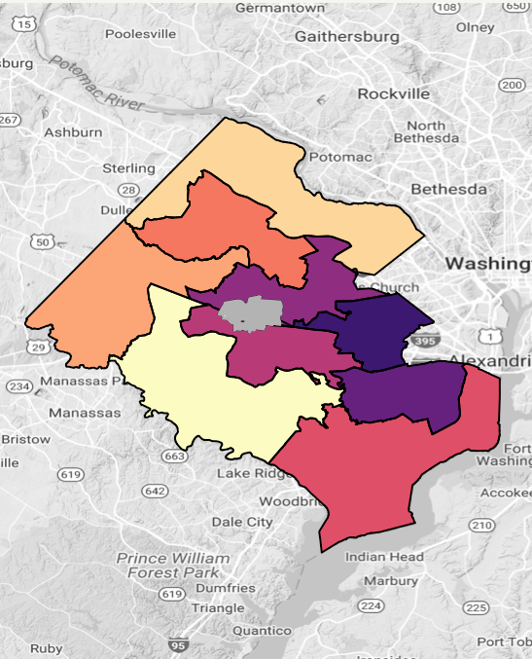
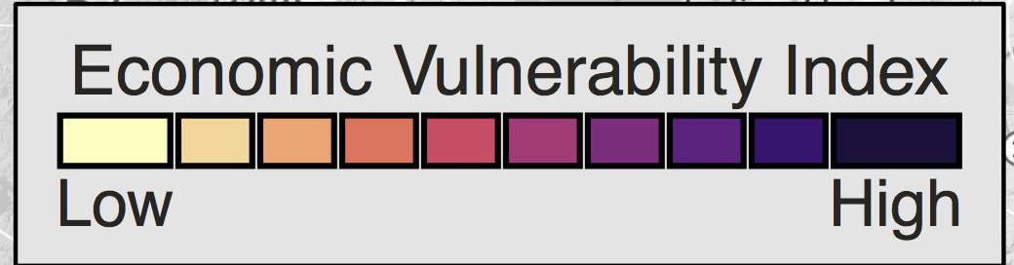
Fairfax Sub-County Vulnerability Indicators
Census Tracts
High School Attendance Areas
Supervisor Districts
Based on a statistical combination of the percentage of Households with:
housing burdens > 50% of Household income
no vehicle
receiving Supplemental Nutrition Assistance Program (SNAP)
in poverty
Source: American Community Survey 2011-2015 aligned to Supervisor Districts using SDAL Synthetic Technology.
Notes:
EVI was divided into deciles

Slide 26
IPF Summary
IPF method:
Combines microdata and summary tables to produce synthetic estimates at new geographies.
Can include housing data for more presise sub-block group estimation.
Is computationally efficient.
Disadvantages:
IPF finds the MLE; this is a modal solution.
Synthetic samples are draws from the microdata that have been repeated multiple times. For some applications, we prefer to have unique samples (e.g. identifiability study for HUD)
Notes:
Project for the HUD on AHS reliability.

Slide 27
Alternate Method: Multiple Imputation
Instead of resampling the microdata, use it to create a synthetic population by imputing missing variables.
Advantages:
Natural Bayesian framework for combining multiple sources of partially observed data
Imputed draws are unique; applications to e.g. disclosure avoidance for the American Housing Survey.
Disadvantages:
Computationally more expensive.
Requires a well specified model for imputation.
Notes:
Using multivariate imputation by chained equations…

Slide 28
Summary
Two methods for creating synthetic populations. Both require the existince of microdata and summary tables.
Iterative proportional fitting:
Fast; resampled from microdata.
Multiple Imputation
Full distributional results; slower and requires well-fit imputation models.

Slide 30
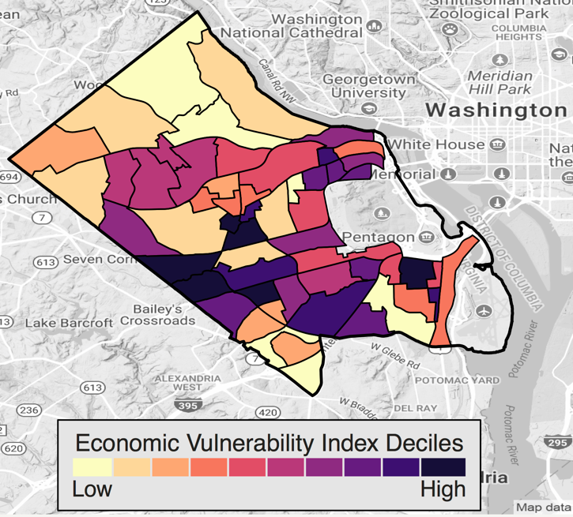
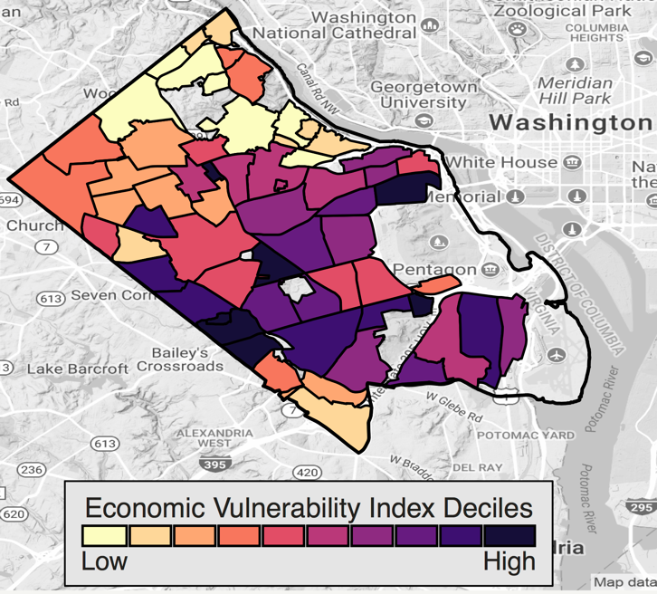
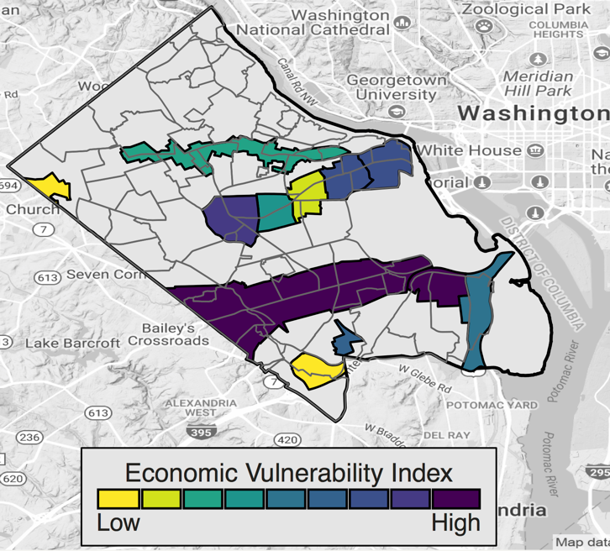
Fairfax County Sub-county Vulnerability Indicators
Arlington Civic Association Neighborhoods
High-Density Planning Regions
Census Tracts
Source: American Community Survey 2012-2016 aligned to geographic areas using SDAL Synthetic Technology.

Slide 31
Multivariate Imputation using Chained Equations (MICE)
Specify a model for each variable conditional on the others in the microdata (e.g. a linear model for household income given taxes, property value).
For each variable in turn:
Draw synthetic values for each household from the conditional model.
Update parameters of the model via Markov Chain Monte Carlo.
Repeat until converge of MCMC.
Notes:
Markov Chain Monte Carlo: Bayesian method for sampling from probability distributions.
Here we leverage it to do this imputation.

Slide 32
Example: Inferring household attributes in Arlington
Local Data
housing price
tax amount from real estate tax assessments
ACS
Income summary
- by block group
ACS Microdata
housing price
tax amount
income
- county sample
Household level Imputation
housing price
tax amount
income
Notes:
Simple example of what our data looks like for the imputaiton of household income using tax amount and property value.
Taxes, Income by block group, ACS microdata, household level imputation.

Slide 33
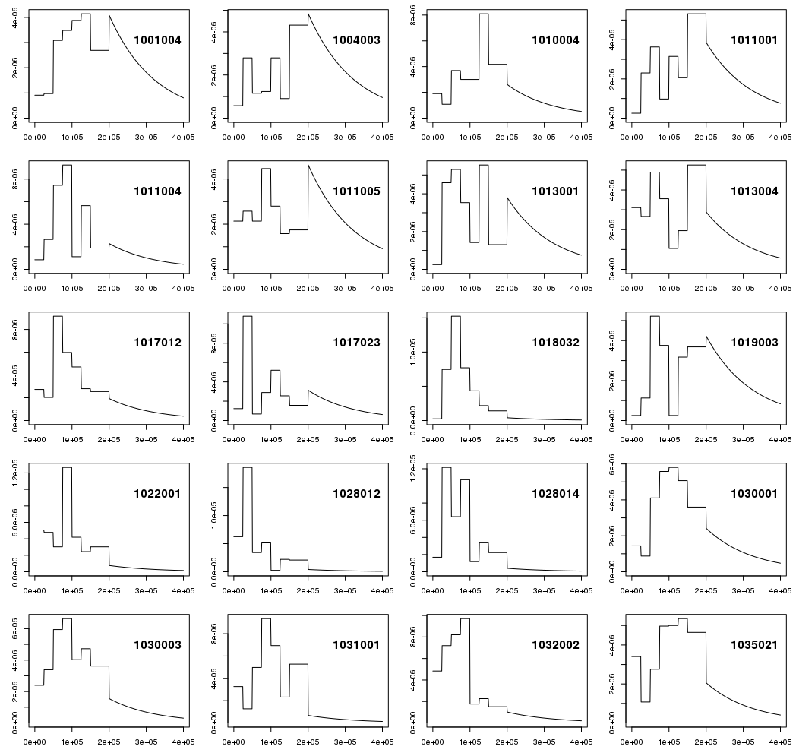
ACS Summary Tables by Block Group
Use ACS tables to create marginal distributions for a variable (e.g. household income) in each block group.
Reweight synthetic draws according to marginal distributions.
Notes:
In this case, the pdf is plotted over a sample of Arlington’s 181 block groups.
I created marginal distribution for income by defining a piecewise uniform distribution over the income bins from the ACS table (e.g. first line is a bin from 0-$50,000), and fitting an exponential tail to the largest category for income ( > $200,000).

